Slide 1
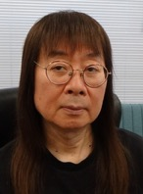
How to Conduct a 6-Year ER Program – Part 2
Ver. 1.01
ERWC7 in Hokkaido, Sep/7/2025
Akio FURUKAWA（古川昭夫）
Founder of SEG
Co-Founder of SSS ER Study Group
If you have any questions about our ER program,
please contact me at fakio@seg.co.jp.

Slide 2
Three Stages in Our ER Program
Stage 1 (takes 0.5 to 3 years)
From the beginning to reaching the
level of being able to read OBW1
Stage 2 (takes 1 to 2 years)
Advancing YL2.0 to YL4.0 or further
Stage 3 (usually takes 1 year)
Advancing YL4.0 to YL7.0

Slide 3
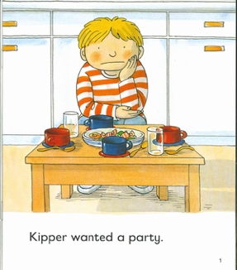
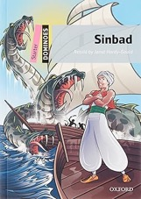


Stage 1 (YL≦1.8)
Grade 7
Advanced Class
starts from YL0.2
6 months
10 months

Slide 4
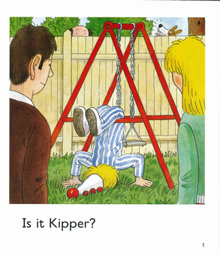


Stage 1 (YL≦1.8)
Grade 7
Basic/Standard Class
starts from YL0.1
6 months
1 year

Slide 5

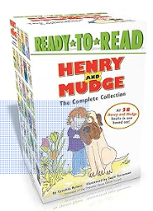

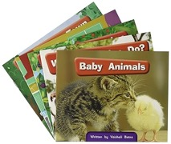
Stage 1 (YL≦1.8)
Books for Stage 1
Cambridge English
Readers
Springboard
Connect
Magic Adventures
Henry and Mudge

Slide 6
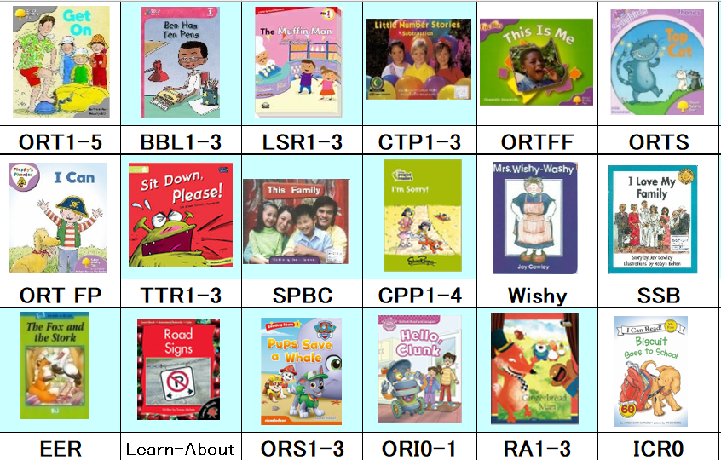
Books for Stage 1 (≦YL0.6, ≦30KW)

Slide 7
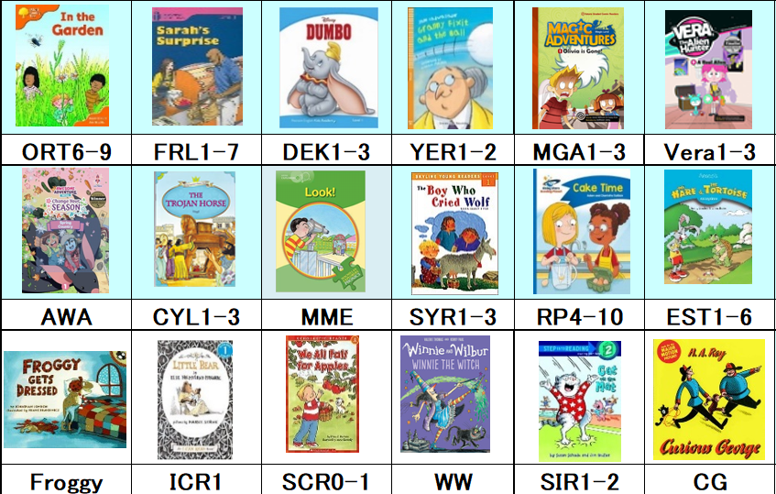
Books for Stage 1 (YL0.6-1.4, 30-100KW)

Slide 8
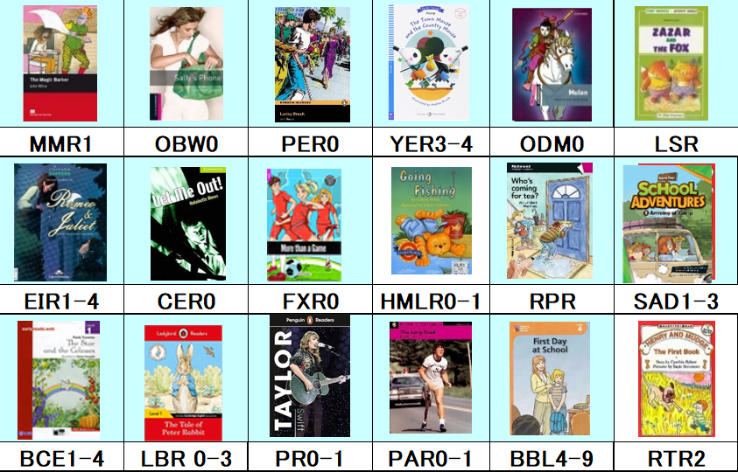
Books for Stage 1 (YL0.8-1.8, 100-300KW)

Slide 9
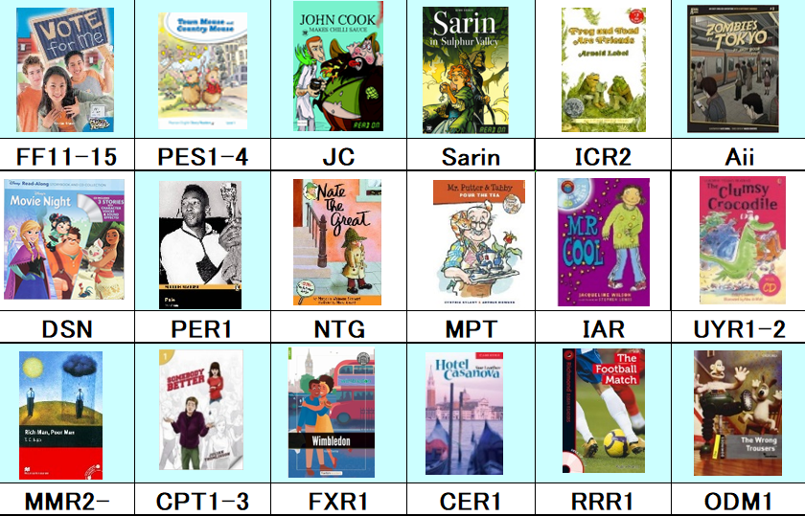
Books for Stage 1 (YL0.8-1.8, 100-300KW)

Slide 10
Do NOT Raise the Level Too Fast
Have students read
i−1, i, i+1 simultaneously or alternately
where
i−1: a level students can read very easily
i: a level students can read easily
i+1: a challenging level
For beginners, we recommend the following ratio, i−1 : i : i+1 = 3 : 2 : 1
43

Slide 11
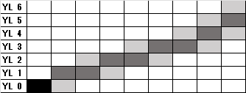
Raise the Level Gradually
Reading level ←
→ Total amount of words a student reads

Slide 12
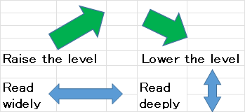
Our Guided ER

Slide 13
Advice to ER teachers
Sometimes, teachers need to advise their students to lower their reading level when they are struggling with reading books that are too difficult, or are really tired, or have personal problems.
When a student loses focus, an effective way to change their mood is to have them read a good picture book or a short graphic novel.
45a

Slide 14
A Wide Variety of Books is Essential
Graded Readers are easy to read, but the total number of GR is not enough for our program.
In addition to GR, we need books for children and young adults. The YL (yomiyasusa level) system makes it possible to level and list the word counts for both GR and authentic books.
46

Slide 15
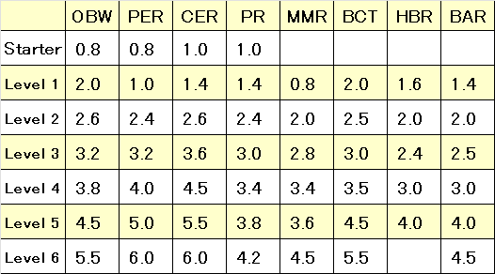
YLs for Major GR
Each YL is determined by the difficulty
of grammar and vocabulary and the total length of each book.
47

Slide 16
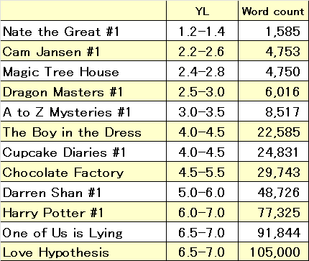
YLs for Major Books
Each YL is determined by the difficulty of vocabulary
and the total length of each book.
48

Slide 17
How to determine a YL by yourself
If you want to determine the YL of your book by yourself, read a few paragraphs in the book, and decide if their difficulty is close to the books which you have already read. If you or your student feel the difficulty of the book is between Book A with YL X and Book B with YL Y, then you can set the YL of the new book as X or Y or (X+Y)/2.

Slide 18
Important Points for Beginners
(1) High level of comprehension and reading volume(=total amount of reading done) are both important. We believe from our experience that:
the growth of English proficiency
is proportional to
(Reading Volume)×LC ^{４}
So, students should read a lot at an 80-90% LC=Level of Comprehension.

Slide 19
(Reading Volume)×LC ^{４}
It implies reading 10,000 words at a 50% LC(Level of Comprehension)
is equivalent to 625 words at a 100% LC,
reading 10,000 words at an 80% LC
is equivalent to 4,096 words at a 100% LC.
I recommend you have your students read at an 80% LC.

