Slide 1
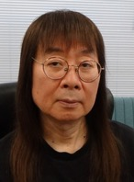
How to Conduct a 6-Year ER Program – Part 3
Ver. 1.01
ERWC7 in Hokkaido, Sep/7/2025
Akio FURUKAWA（古川昭夫）
Founder of SEG
Co-Founder of SSS ER Study Group
If you have any questions about our ER program,
please contact me at fakio@seg.co.jp.

Slide 2
Important Points for Beginners
(2) In order to be able to read a book with a high level of comprehension, reading the same book two or three times (listening, shadowing and reading aloud) is recommended.
(3) Raise the level slowly and carefully.
We set ORT3 as the goal for our basic and standard classes at the end of Grade 7.

Slide 3





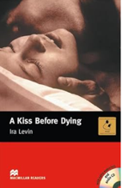


Stage 2 (YL2.0-4.0)
Starts from
(2.0, 5440) (2.0, 4082) (2.2 4753) (2.5, 6016)
Ends at
(3.6, 15198) (3.6, 20154) (3.8, 17645) (3.5, 15596)

Slide 4
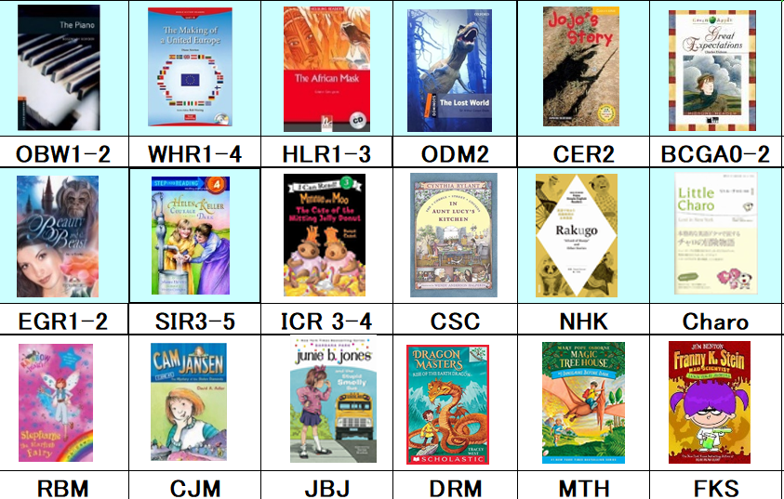
Books for Stage 2 (YL1.8-2.8, 200-700KW)

Slide 5
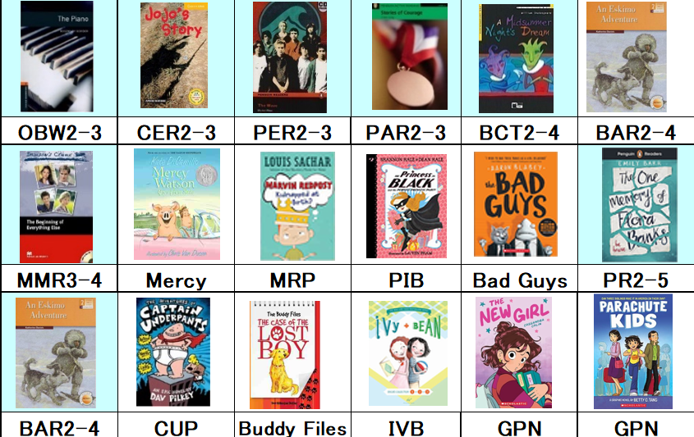
Books for Stage 2 (YL2.4-4.0, 0.5-1.5MW)

Slide 6







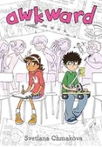
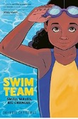
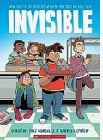

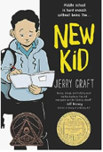
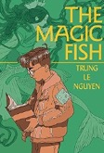



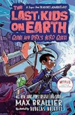
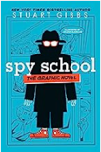

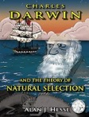

Graphic Novels for Stage 2 (YL3.5-4.0)

Slide 7






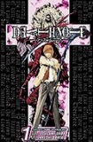














Japanese Manga for Stage 2 (YL3.5-4.0)
55

Slide 8
Important Points for Stage 2 Students
(1) Stop listening to the audio when the students can read more fluently than the audio.
(2) Choose i-1, i, i+1 books.
(3) Raise the level very carefully.
Some students only need one year to progress from Stage 2 to Stage 3, but some students need 2 or 3 years to reach Stage 3. When they are ready, choose a book like Charlie and the Cholate Factory to challenge the students.

Slide 9








Stage 3 (YL 3.5-7.0)
Starts from
(4.5, 20497) (4.0, 22586) (4.0, 24831) (4.5, 29743)
Ends at
(6.0, 70000) (6.5, 91844) (6.5, 75000) (6.5 103029)

Slide 10
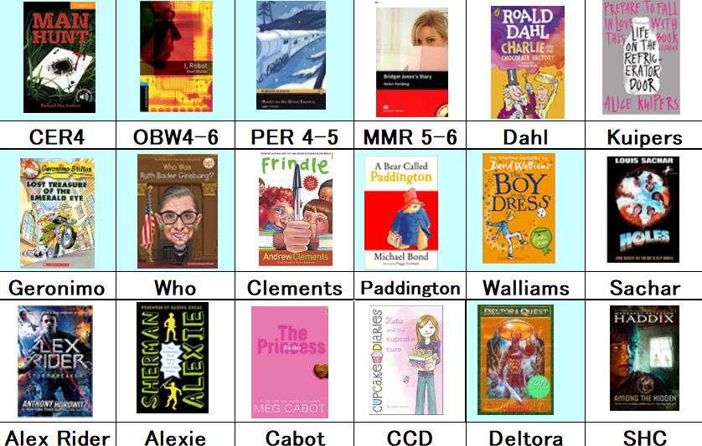
Books for Stage 3 (YL3.5-5.5, 1.5M-2.5M)

Slide 11
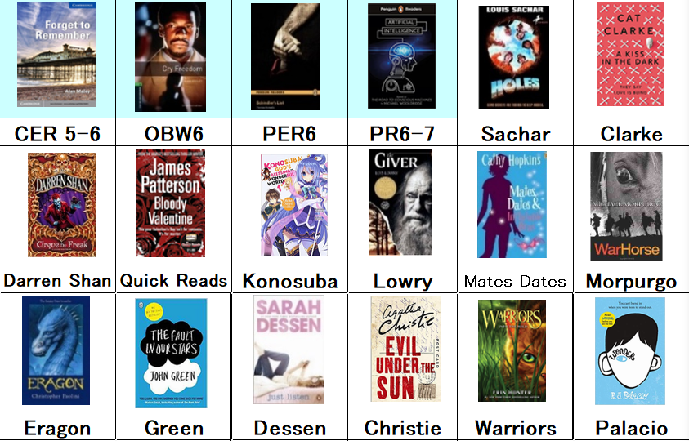
Books for Stage 3 (YL4.5-6.5, 2.0M-)

Slide 12
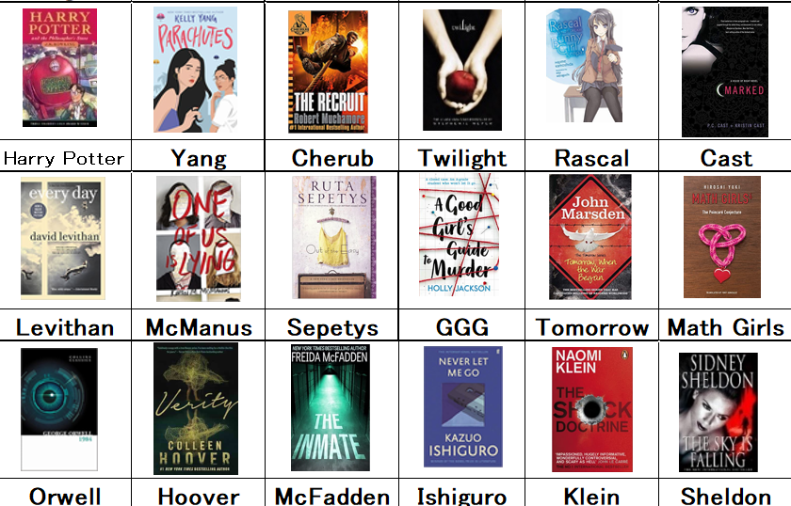
Books for Stage 3 (YL4.5-6.5, 2.0M-)

Slide 13

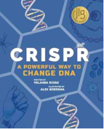




Important Points for Stage 3 Students
(1) Choose books related
to students’ desired
major in university.
(2) Choose young adult
novels which are written
for high school students.
(3) Choose easy books when students have little time to read or are really tired.

Slide 14
Three Merits of ER
Students can improve their English skills at their own pace through ER.
Students acquire diverse knowledge through reading.
Reading books develops students’ empathy, which is one of the most important skills required by modern society.

Slide 15
Conclusion
It usually takes two or three years to reach YL2 with no prior English experience.
However, our experience shows that after reaching YL2, students can reach YL4 or higher within a relatively short period of time.
So it is very important not to haste your students to reach YL2. They might need 4 years, but waiting patiently will pay off.

Slide 16
A Word of Encouragement
Even a math teacher who could not speak English well can be the best ER teacher in the world after ten years of reading a lot of easy books.
All of you are already good at teaching English, so you can be great ER teachers
if you read a lot of easy books for your students.
Enjoy reading for your own pleasure and your students!

Slide 17
Acknowledgements
Many thanks to
Tanya Petrova, Mark Koopman,
Jeremy Lewison, Soichirou Hirata,
and Minami Kanda
for reviewing this presentation.
If you are interested in our OC program,
contact Mr. Mark Koopman at mkoopman12@gmail.com.

