Slide 1
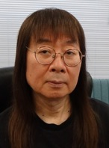
How to Conduct a 6-Year ER Program
Ver. 1.01
ERWC7 in Hokkaido, Sep/7/2025
Akio FURUKAWA（古川昭夫）
Founder of SEG
Co-Founder of SSS ER Study Group
If you have any questions about our ER program,
please contact me at fakio@seg.co.jp.

Slide 2
Today’s Topics
1 What brings a math teacher here
2 Our ER English program
including reading logs of two students
3 How much our students read
4 The correlation between total amount of
words read and TOEFL/Linguaskill test
scores
5 How students progress through reading levels
6 Conclusion
Notes:
2

Slide 3
What Brings a Math Teacher Here
As soon as I entered university, I started my career as a math teacher at a juku. When I was at graduate school in 1981, I founded my own juku, SEG(Scientific Education Group) to teach math and science to junior and senior high school students. They come to SEG after school and during school holidays.
Now, about 2,700 students study math at SEG, 2,100 English, 670 chemistry and 460 physics.
Notes:
3

Slide 4
(cont’d)
I was interested in teaching math with a computer algebra system and was invited to Teachers Teaching with Technology Meeting in Ohio in 1995. Six Japanese math teachers were invited, and the teachers from abroad were asked to give short speeches in English. The Japanese teachers all gave speeches and were followed by a Swedish teacher. He said, “Please, rest assured. I will speak in 100% comprehensible English.”
Notes:
4

Slide 5
(cont’d)
He was so rude that we all got angry, but I must agree our speeches were indeed terrible. As I was the CEO of my own juku, I decided that we had to improve our English program so that none of our graduates would experience such humiliation. I studied a lot of methods of teaching English for 5 years. Finally I came to the conclusion that reading a lot of easy books might benefit Japanese students.
Notes:
5

Slide 6
(cont’d)
I met Mr. Kunihide Sakai and started extensive reading myself. I started with very easy books and read a million words in three months. In 2001, Mr. Sakai and I founded the SSS Extensive Reading Study Group, and advocated for the Start with Simple Stories method under the slogan “Just Read One Million Words!” We created the YL(Yomiyasusa Level) and SSS(Start with Simple Stories) systems and SEG started teaching English through ER in 2002.
Notes:
6

Slide 7
(cont’d)
In 2001, I also met Dr. Stephen Krashen and asked him if he thought ‘i-1’ input was useful for learners. He said yes, and I felt reassured that the SSS method would be successful. I also met Dr. Beniko Mason and went to observe a class at her uni. Her lesson was excellent but it was not an ER class. At that time, as far as I know, only Mr. Sakai’s uni classes and those at SEG were taught entirely through ER. I observed and helped his uni classes for a year.
Notes:
7

Slide 8
(cont’d)
Mr. Sakai and I both support
(1) Comprehensible Input Hypothesis,
(2) Start with Simple Stories method.
However, we have different opinions on
(3) S-to-S Interaction,
(4) Explicit Teaching,
(5) Intensive Reading.
Contrary to Mr. Sakai, I think (3)-(5) might also benefit the students in addition to ER.
Our program is based on all of the above.
Notes:
8

Slide 9
Our ER English Program
1 Grade 7 to Grade 12
2 For 7th graders to 10th graders
ER 80 min ＋ OC 80 min
For 11th graders ER 90min + OC 90 min
For 12th graders ER 90min + UEEP 90min
(UEEP=University Entrance Exam Preparation)
3 50 lessons in a year (except Grade 12)
31 weekly lessons + 19 seasonal lessons
4 The average number of students
in a class is 12.
Notes:
9

Slide 10




Reading Log of Student A (1)
2019/03 0KW Start from ORT1
(Grade 7) Basic class→Standard class
2020/02 164KW ORT2, CYL1
(Grade 7)
2020/08 470KW WHR1
(Grade 8) Standard class→Advanced class
2021/02 793KW ODM0, PAR0
(Grade 8)

Slide 11




Reading Log of Student A (2)
2021/06 1.30MW Magic Tree House
(Grade 9)
2022/02 2.31MW Mates Dates
(Grade 9)
2022/06 3.36MW House of Night
(Grade 10)
2023/02 5.04MW Tomorrow
(Grade 10)

Slide 12




Reading Log of Student A (3)
2023/06 5.40MW The Love Hypothesis
(Grade 11)
2024/02 7.31MW The Martian
(Grade 11)
2024/06 8.51MW Fourth Wing
(Grade 12)
2024/12 9.42MW Iron Flame
Passed the EE for U of Tokyo

Slide 13


Reading Log of Student B (1)
2019/03 0KW Start from ORT1
(Grade 7) Basic class
2020/02 76KW ORT2, LLL2
(Grade 7) Basic class→Standard Class
2020/08 120KW ORT4
(Grade 8)
2021/02 237KW FRL3
(Grade 8) Standard Class→Advanced Class

Slide 14



Reading Log of Student B (2)
2021/06 349KW YER2, PAR0
(Grade 9)
2022/02 474KW ODM1
(Grade 9)
2022/06 667KW OBW1, PAR2
(Grade 10)
2023/02 844KW CER2, DRM
(Grade 10)

Slide 15




Reading Log of Student B (3)
2023/06 950KW A to Z Mysteries
(Grade 11)
2024/02 1.10MW A. Christie(GR)
(Grade 11)
2024/06 1.48MW A. Christie(QR)
(Grade 12) 2024/12 1.68MW
Where the Crawdads Sing
Passed the EE for U of Tokyo

Slide 16
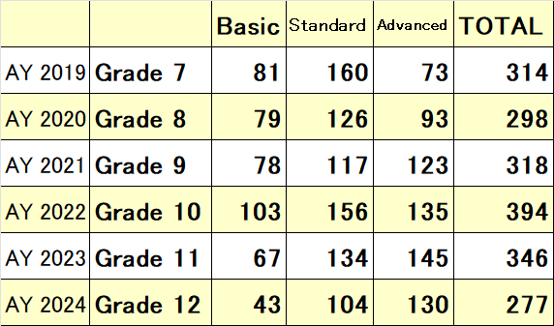
Three Levels of Classes
Each grade has classes in 3 levels, basic, standard, and advanced. The numbers of students in each level in April are as follows:
Our academic year starts in March and ends in February.
Notes:
16

Slide 17
Our Lesson Descriptions (1)
Grade 7
40 min: ORT Assigned Reading + Quiz
(with explanations in basic and standard classes)
25 min: Individual Guided Reading
5 min: Record, Return, Borrow
10 min: Phonics + Vocabulary
20 min: Break
80 min: Oral Communication & Grammar
(conducted by native teachers
using TPRS and MovieTalk)

Slide 18
Individual Guided Reading
We use the Individual Guided Reading method.
In our method, ER teachers
1) observe how Ss are reading in class
2) track how the Ss feel about what they read
by reading their reading log notebooks
3) select books suitable for each student
Teachers also ask Ss what kind of books they want to read in order to select their books.

Slide 19
TPRS method
In our Oral Communication classes(Grades 7 and 8), TPRS(Teaching Proficiency through Reading and Storytelling) is the primary method.
TPRS was developed by Blaine Ray, a high school Spanish teacher in California, during the 1990s. It is also based on Krashen’s Comprehensible Input Hypothesis.

Slide 20
Our Lesson Descriptions (2)
Grade 8 to Grade 10
5 min: Writing (grammar-based translation)
65 min: Individual Guided Reading
10 min: Listening or Shadowing
20 min: Break
80 min: Oral Communication & Grammar
(conducted by native teachers)

Slide 21
Our Lesson Descriptions (3)
Grade 11
5 min: Writing
75 min: Individual Guided Reading
10 min: Listening from past entrance exams
20 min: Break
90 min: Oral Communication and Intensive
Reading including free discussion
and essay writing
＊We also have UEEP classes for 11th graders.

Slide 22
Our Lesson Descriptions (4)
Grade 12
60 min: Individual Free Volunteer Reading
10 min: Listening from past entrance exams
10 min: Shadowing and vocabulary check
10 min: Solving grammar problems from past
entrance exams
20 min: Break
90 min: Uni Entrance Exam Preparation
Lecture or practice test
(conducted by Japanese teachers)

Slide 23
Our Staff
1 ER full-time teachers 5
ER contract-based teachers 46
ER assistant teachers 54
2 OC full-time teachers 15
OC contract-based teachers 6
3 Japanese teachers for UEEP 6
4 Office staff full-timers 6
part-timers 6
Notes:
23

Slide 24
Why Only 5 ER Full-Timers?
It is because there are almost no teachers who have experience
Teaching English through ER.
Most of our assistant ER teachers are uni students who took ER classes at SEG. It takes at least one year for an assistant teacher to be able to teach ER classes on their own.
Notes:
24

Slide 25
Number of Classes
N of Cls | 2006 | 2011 | 2016 | 2021 | 2023 | 2025
Grade 7 | 5 | 24 | 26 | 32 | 28 | 31
Grade 8 | 2 | 29 | 26 | 29 | 31 | 32
Grade 9 | 3 | 19 | 24 | 25 | 29 | 28
Grade 10 | 5 | 19 | 25 | 26 | 40 | 37
Grade 11 | 1 | 12 | 21 | 22 | 26 | 27
Grade 12 |  | 6 | 13 | 14 | 16 | 17
Total | 16 | 109 | 135 | 148 | 170 | 172
Av NS | 9.8 | 9.4 | 11.8 | 12.0 | 12.0 | 12.1
Notes:
25

Slide 26
Number of Students
N of S | 2006 | 2011 | 2016 | 2021 | 2023 | 2025
Grade 7 | 56 | 209 | 276 | 346 | 302 | 327
Grade 8 | 14 | 261 | 280 | 324 | 334 | 370
Grade 9 | 33 | 181 | 265 | 318 | 371 | 327
Grade 10 | 50 | 183 | 292 | 316 | 460 | 438
Grade 11 | 4 | 112 | 212 | 290 | 344 | 379
Grade 12 |  | 77 | 138 | 184 | 230 | 287
Total | 157 | 1023 | 1463 | 1778 | 2041 | 2128
In 2002, we had only 30 students in our ER program.
Notes:
26

Slide 27
Our Budget for Books
(1) The tuition fee for a one year program is about JPY364K, or USD2.5K, per student, so our annual income is around JPY760M, or USD5.3M. (USD1=JPY145)
(2) We spent JPY18M, or USD124K, or 2.3% of our total income, on buying books for ER last year. This allowed us to buy 10K books. Last year, 2K books were lost, and 3K books were donated to other schools. Now, we have about 600K books.
Notes:
27

Slide 28
Our Principles for Extensive Reading
(1) Start with Simple Stories
Most students start reading from
YL0.1-0.5 books.
(2) Teachers choose appropriate books
for each student
Different from free volunteer reading.
(3) A diverse selection of books.
To ensure (1)&(2), we have 600K books.

Slide 29
Our Rules for Extensive Reading
(1) Don’t translate English into Japanese
(2) Read at an 80-90% level of understanding
(3) Guess the unknown words
instead of consulting a dictionary
(4) Read for an hour in every lesson
(5) Read for at least an hour as homework
every week if possible

Slide 30
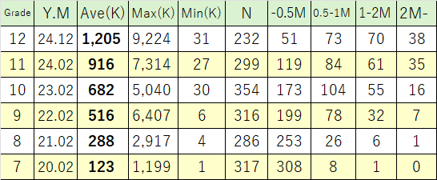
How Much Students Have Read
All the students enrolled in the ER program at the time.
K means 1,000 words and M means 1,000,000 words.

Slide 31
Drop in the Max Word Count Between Grades 9 and 10
At many jukus, students can join a class and leave at any time.
At the end of Grade 9, two top readers quit our program.
So the student who read 5,040KW at the end of Grade 10 was the third-place reader who read 3,360KW at the end of Grade 9.

Slide 32
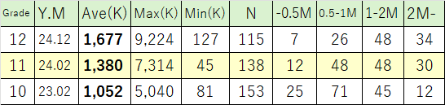
How Much Students Have Read
Students who did ER for more than 3 years
K means 1,000 words and M means 1,000,000 words.

Slide 33
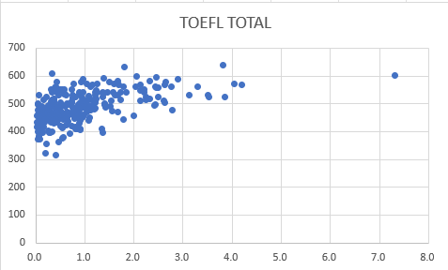
TOEFL(ITP) Scores and the Total Amount of Words Ss Read
x-axis: Million Words y-axis: TOEFL ITP Score
N=287, r=0.54, Ave=487, 11th Graders in January of 2024.

Slide 34
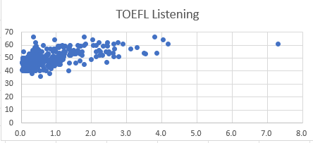
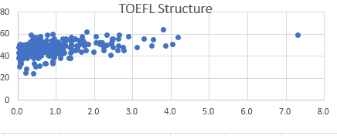
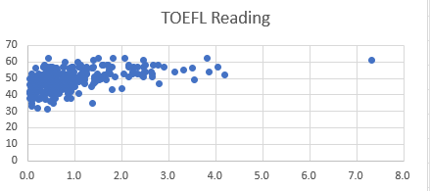
Listening Section
Ave=49.9
r=0.58
Structure Section
Ave=46.8
r=0.41
Reading Section
Ave=49.8
r=0.46
x-axis: Million Words y-axis: TOEFL ITP Deviation Value

Slide 35
Why the Correlation between Listening and WC Is Relatively Strong
The section score - WC correlations coefficients are as follows:
Listening - WC: r=0.58
Reading - WC: r=0.46
Structure - WC: r=0.41
In the listening section, the English is relatively easy, so the correlation with WC is strong.
The weak correlation between Structure(Grammar) and WC suggests explicit grammar learning might be necessary to get a high score on a TOEFL ITP test
and, possibly, a university entrance exam.

Slide 36
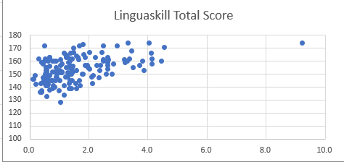
Cambridge Test Scores and the Total Amount of Words Ss Read
x-axis: Million Words y-axis: Cambridge Linguaskill Score
N=152, r=0.47, Ave=154, 11th Graders in November of 2023.
C1:180, B2:160-179, B1:140-159, A2:120-139, A1:100-119

Slide 37
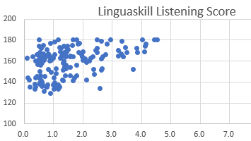
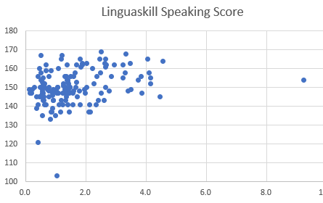
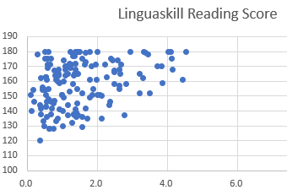
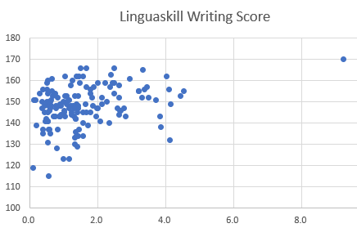
Listening: Ave=158, r=0.43
Speaking: Ave=150, r=0.31
Reading: Ave=148, r=0.32
Writing: Ave=138, r=0.32
x-axis: Million Words y-axis: Cambridge Linguaskill Score

